Slide 1
Saving and Controlling Electricity
A system that helping citizens to conserves electricity

Slide 2
Project Charter
Project name: Saving and Controlling Electricity
Project sponsor: Ministry of electricity and energy
Project manager: Eng/ Mohammed Salah
Purpose of the project: helping citizens to conserves electricity.

Slide 3
Business case:
the application in used to bring money by saving electricity and control
electricity-power and function through Egypt.
If you keep devices plugged in and running when they're not in use the result
is an increase in electrical use and, consequently, a bump in the amount of
greenhouse gases that enter the atmosphere. Leaving your laptop plugged in
all the time will use nearly 300 kilowatt hours (kWh) of electricity each year
and a desktop computer left to idle will use more than 600 kW of electricity
annually.
Even leaving your fully charged cellphone attached to its charger can waste
almost 20 kWh a year it led to raise the cost of electricity bill and affect in your
salary.
Conserving energy is not just about saving on your electricity costs. The
Organization for Economic Co-operation and Development warns that given
the current trends, energy-related emissions will increase by 70 percent by
2050. This can accelerate the negative consequences of climate change
including higher temperatures and a rise in the frequency of extreme weather
events for this the ministry of electricity decided to make a mobile phone app
that enable you to control of your home electricity from any place.
The app will be attached with the all devices at your home and about
if you can turn on/off any devices you want from any place even if
you are out of home, the app also will see your which devices are
turned on and which turned off.

Slide 4
Project scope
1- The application will show the user the status of all devices (On or Off).
2- It show the user with the most electricity consuming devices and
suggests to turn it off.
3- It sends a notification to the user if there are a device still turned on of
along time (like chargers), and the user can allow access to turn it off
automatically.
4- It provide the user with a report (daily, weakly, or monthly) of the
Consumption of each device to help him to reduce the total
consumption.
5- The application also allows the user to pay electricity bills with it.

Slide 5
Key deliverables of the project:
The application allows the user to control in turn on and turn off of
remote devices and the consumption of each device of electricity.
And you can put a limit time to turn off all devices, by this way you can
assure that all devices will turn off after this time.
Project
milestones
(Time line of
project
- In the first two weeks, the team of electrical engi

Slide 6
Project milestones (Timeline of project):
- In the first two weeks, the team of electrical engineers will collect
information on remote control and consumption of electrical devices.
- For month, engineers will make remote receivers.
- For Two weeks, a team of programmers will make the mobile
application.
- The project is being tested for a week

Slide 7
Project resources:
1- A team of electrical engineering.
2- A team of programing.
3- Device of receiver
Budget: 414,000$.
Staff:
- A team of electrical engineers.
- A team of programmers.
Vendor: Marketing companies, and internet markets (like Amazon,
and Google play)

Slide 8
Budget
414,000 $ (includes servers, project licenses, developers, designers,
training)

Slide 9
Project scope

Slide 10
1-Project scope description:
• It is an application you use to control the electric devices so that
you can turn on/off any device at home from anywhere.
• The app also will show you all devices at home whatever it is turn
on/off.
• You can pay the electricity bill with the app

Slide 11
2-Project acceptance criteria:
• Paying the electricity bill.
• Beautifully user interface.
• Easy to use, faster and comfortable.

Slide 12
3-Project deliverables:
• Project plan, reports, documents and resources which return to
the company.
• Saving money, electricity and time.
4-Project execution:
• One of customers’ requirements that the app show him the
average of using electricity every month, but the sponsor and
manager refuse this request as it need a lot of time and cost.

Slide 13
5-Project constraints:
• Rules of company and policies.
• Budget.
• Time of submit.

Slide 14
6-Project assumptions:
• This application can run only on The IOS and Android
operating system.

Slide 15
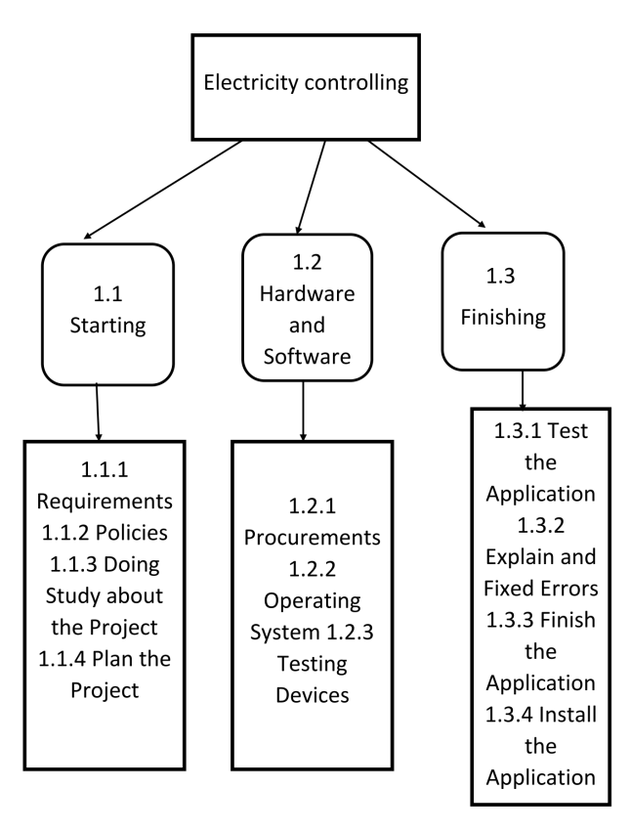
WBS

Slide 16
Dictionary of WBS

Slide 17
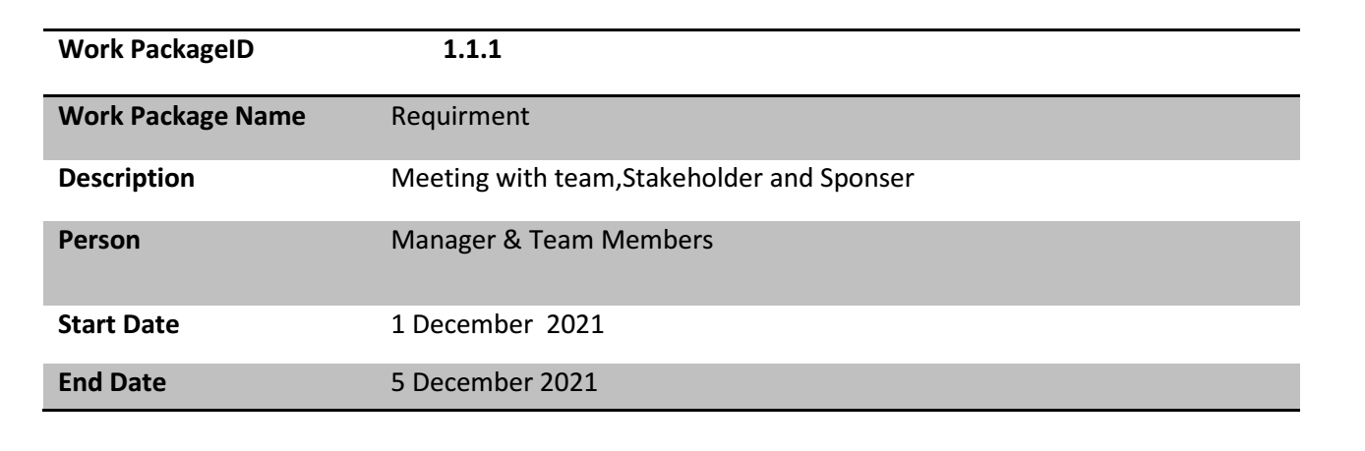
1.1 Starting

Slide 18
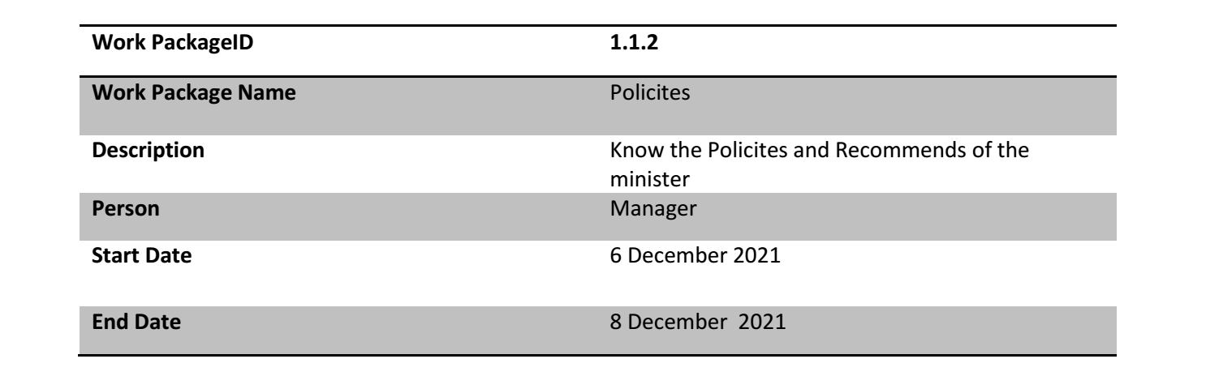

Slide 19
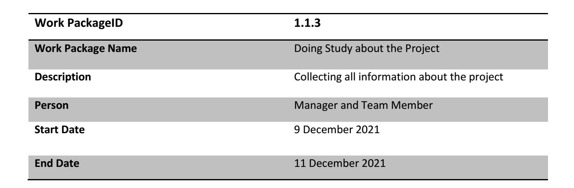

Slide 20
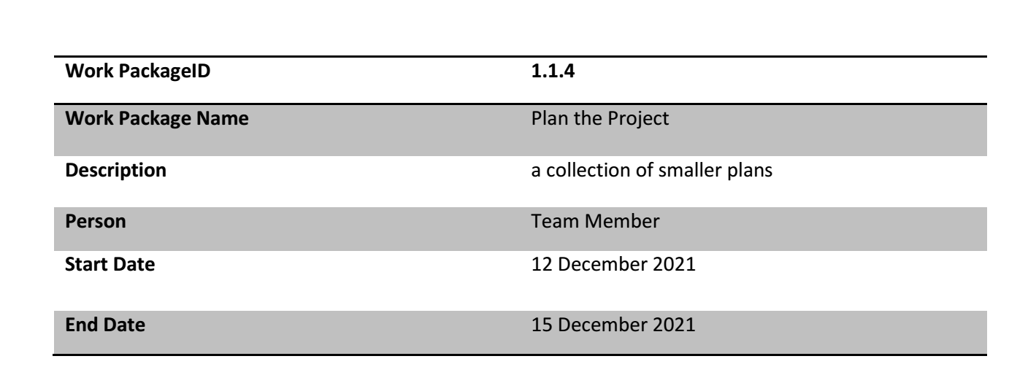

Slide 21
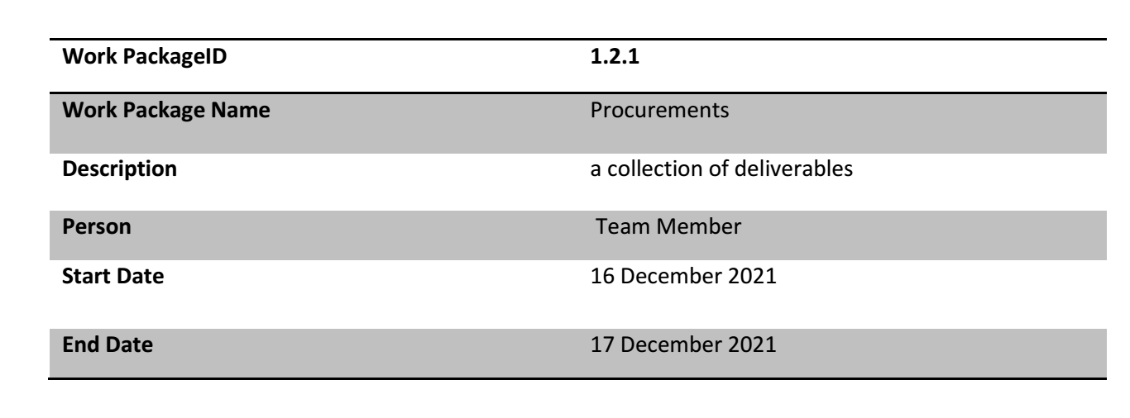
1.2 Hardware and Software

Slide 22
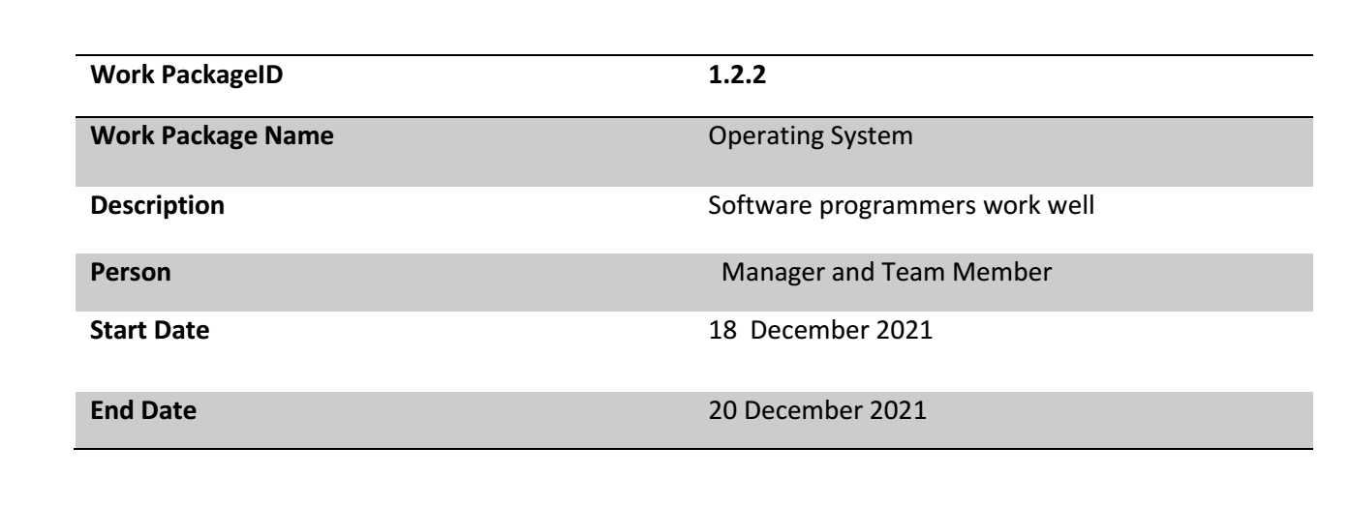

Slide 23
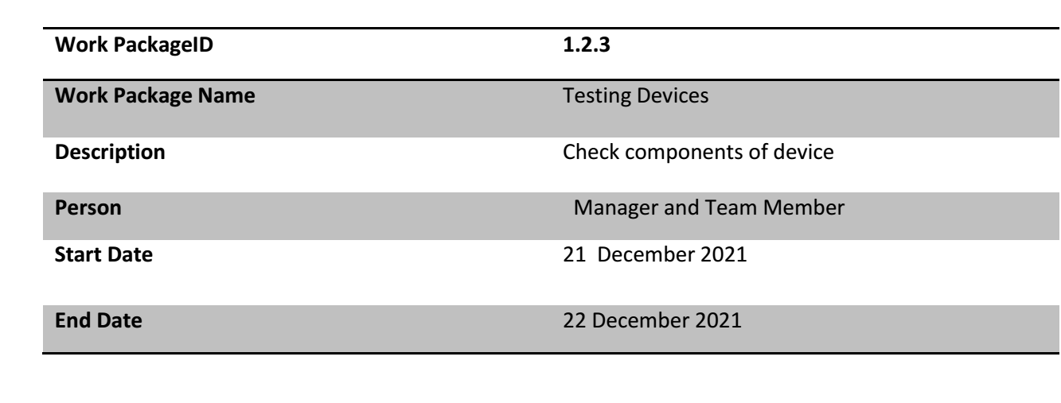

Slide 24
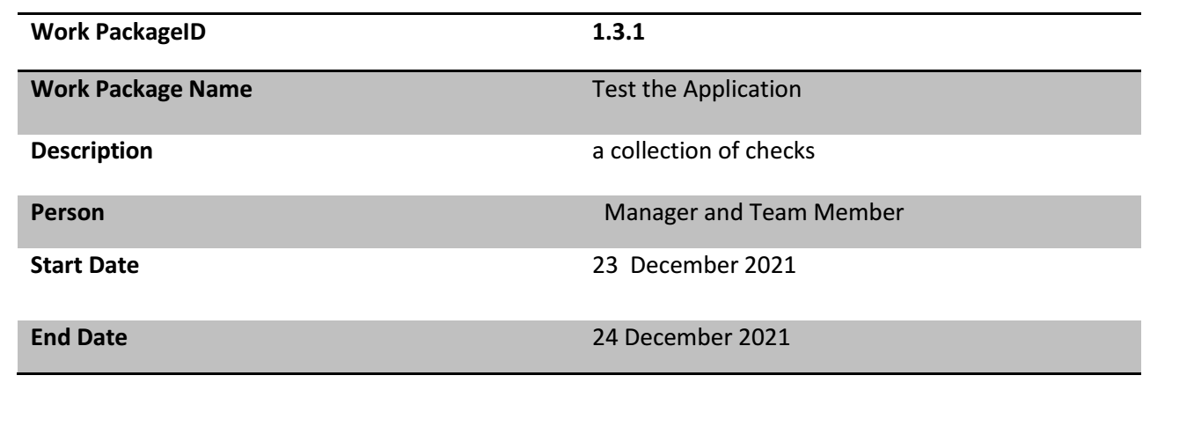
1.3 Finishing

Slide 25
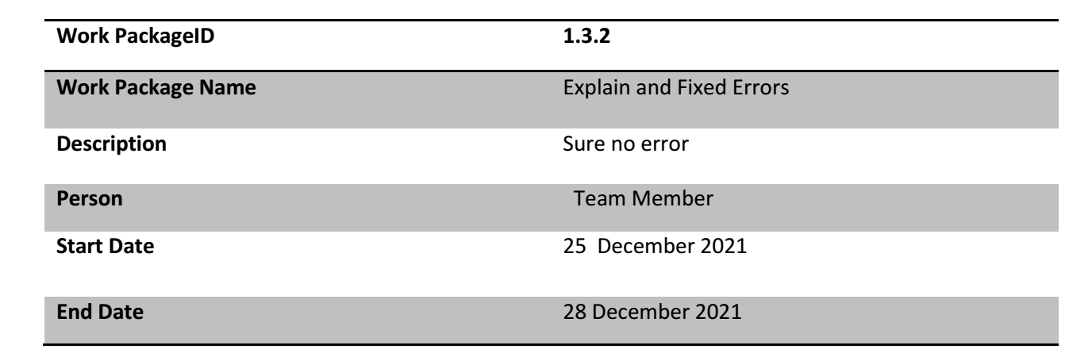

Slide 26
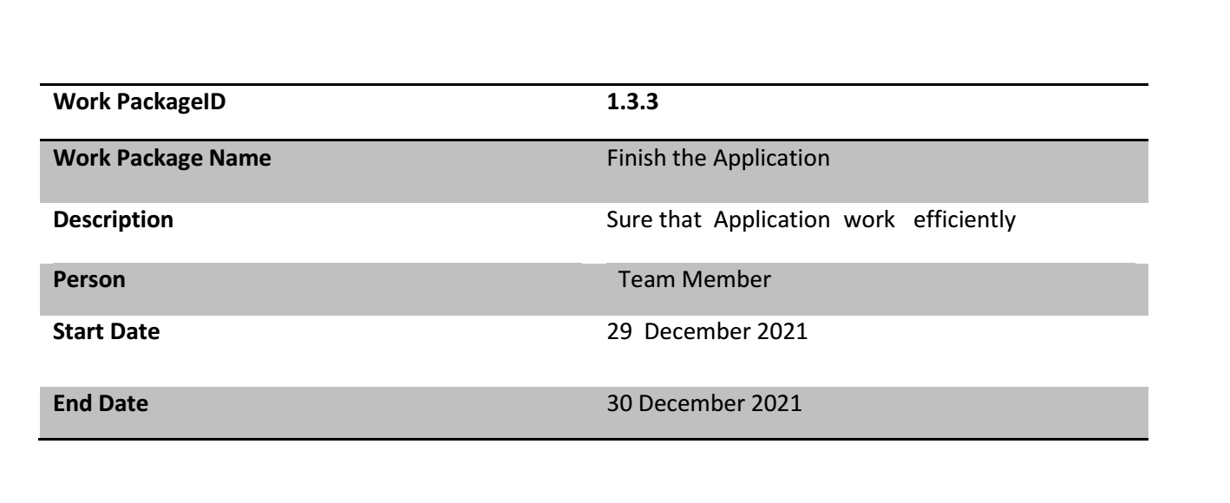

Slide 27
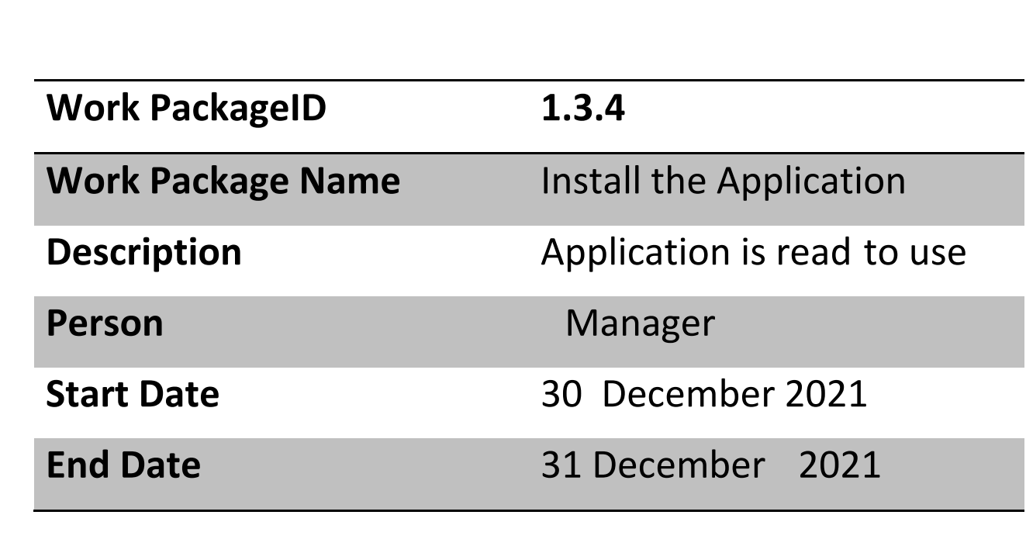

Slide 28
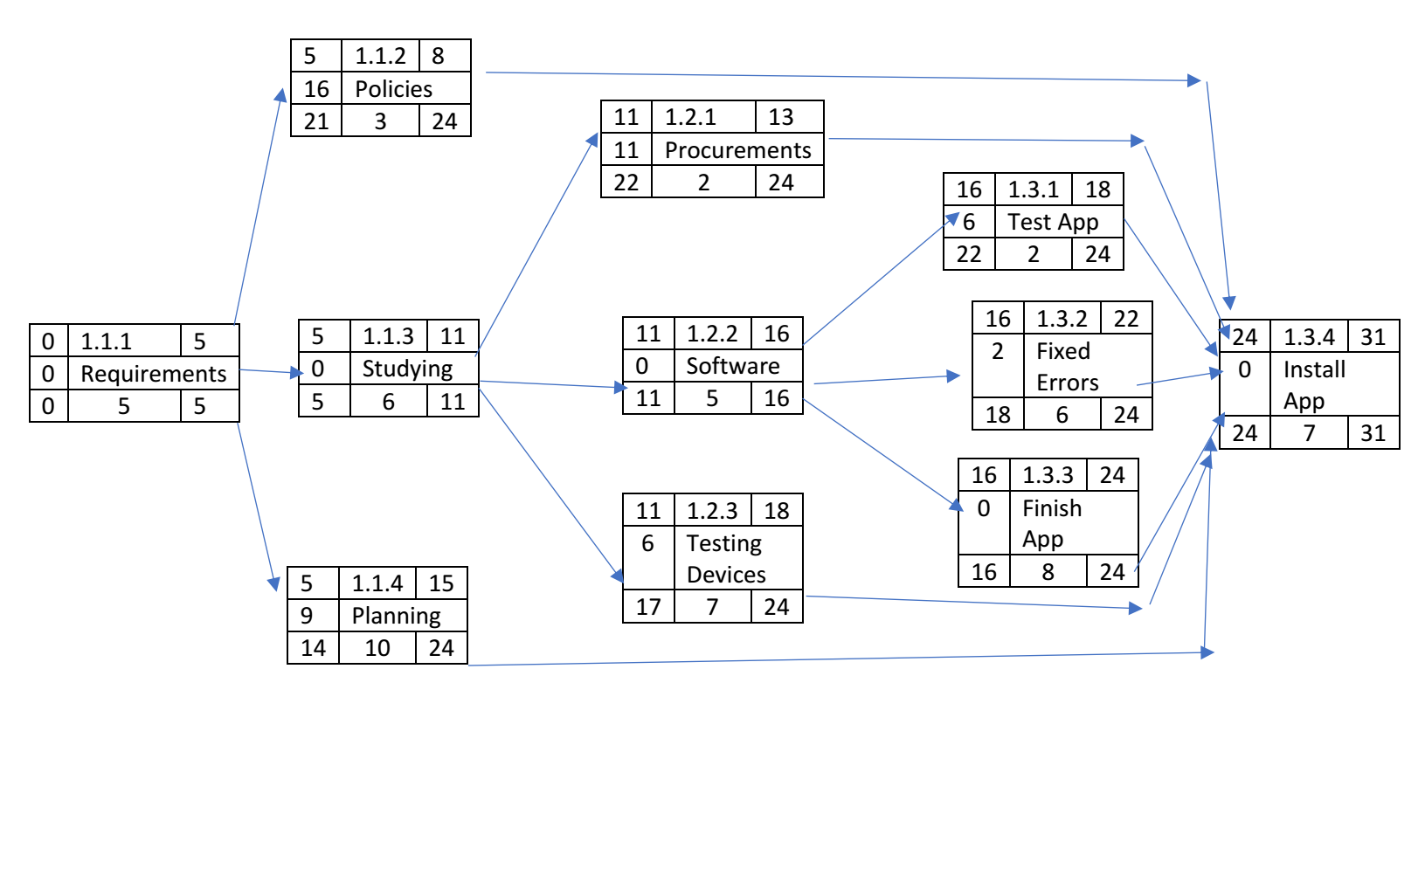
Network

Slide 29
Resourse Constrained

Slide 30
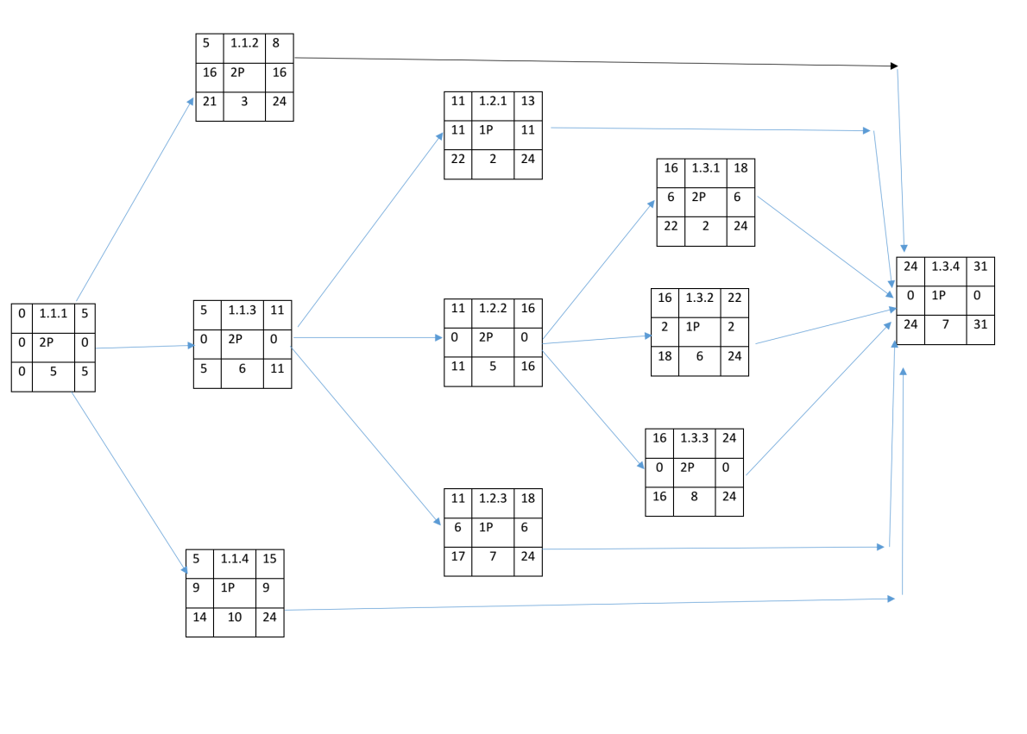

Slide 31
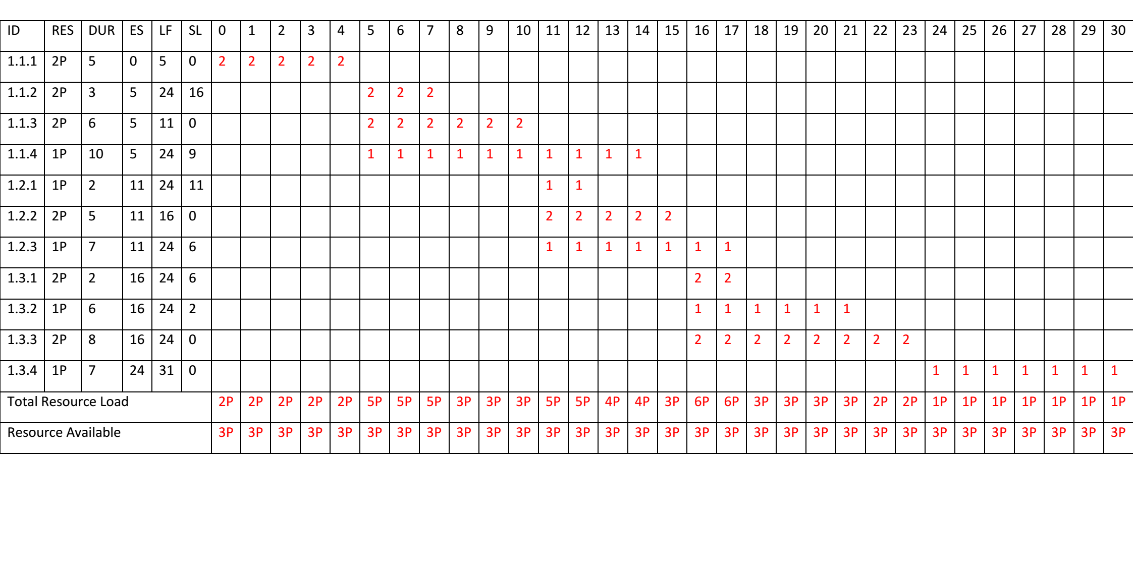

Slide 32
Budget Baseline

Slide 33
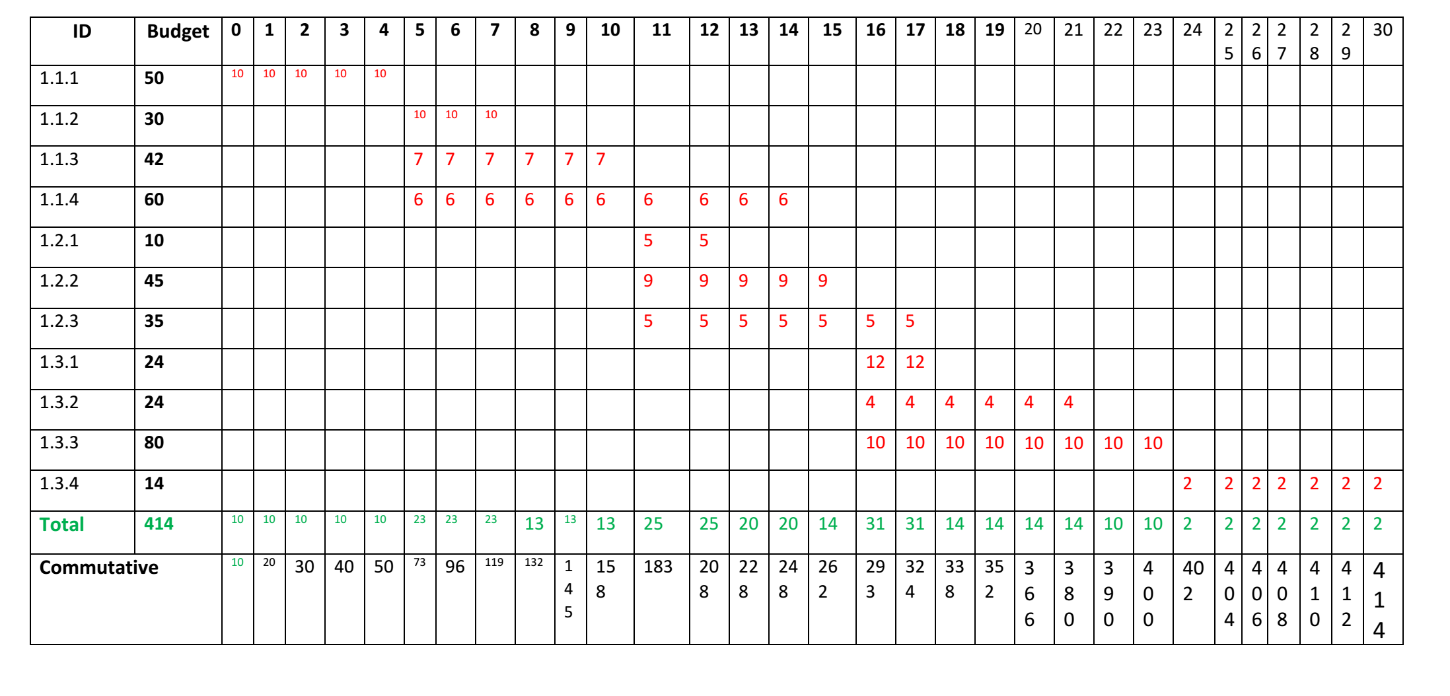

Slide 34
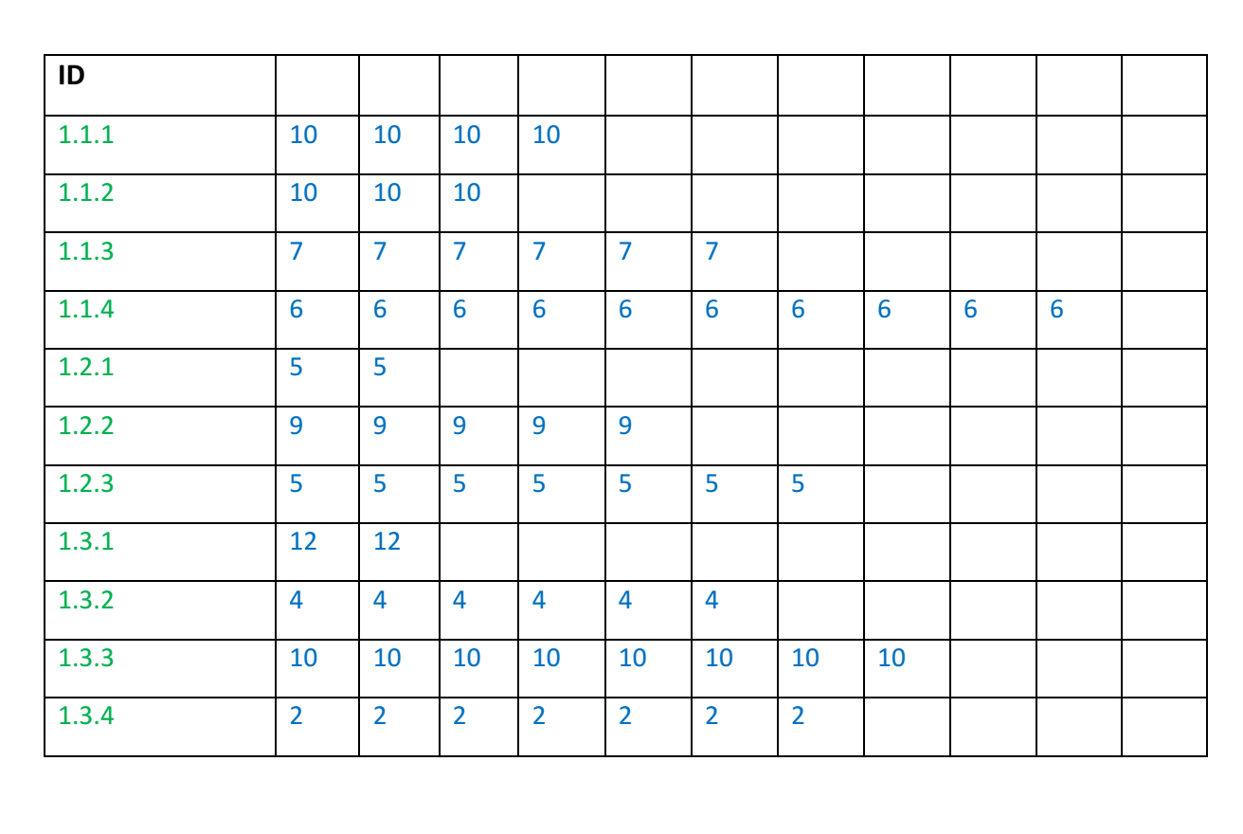

Slide 35
Risks

Slide 36
Negative risks:-
a-Interruption of the Internet.
b-hackers.
c-One of our employee leave the company.
d-Another competitive company make the
same technology with better quality than us.
-Damage in the receivers.
-Increase in the cost.
-The lack of efficiency sufficient in the
receiver or the teams.
-Not to satisfy the users of product.

Slide 37
Positive risk:-
-There is only our company in the market.
-Make a change in company that may
improve our technology.
-This application work The IOS and
Android and windows operating system

Slide 38
Team members
عبدالرحمن صالح الدين سعد محمود بندارى
عبدهللا عبدالعال محمد مدني
عبدهللا عبدالصبور علي محمد
عبدالرحمن عبدالماجد يوسف نوح
عبدالرحمن فتحي ابوزيد عبدالسالم
احمد عرابي مبارك عرابي

